Slide 1
Chinese Checkers
The pages below contain game boards for three versions of simplified Chinese Checkers.
On your computer you can play games on these boards if you use the design mode, not the presentation mode of power point.
With your mouse you can move the pieces on the board.

Slide 2
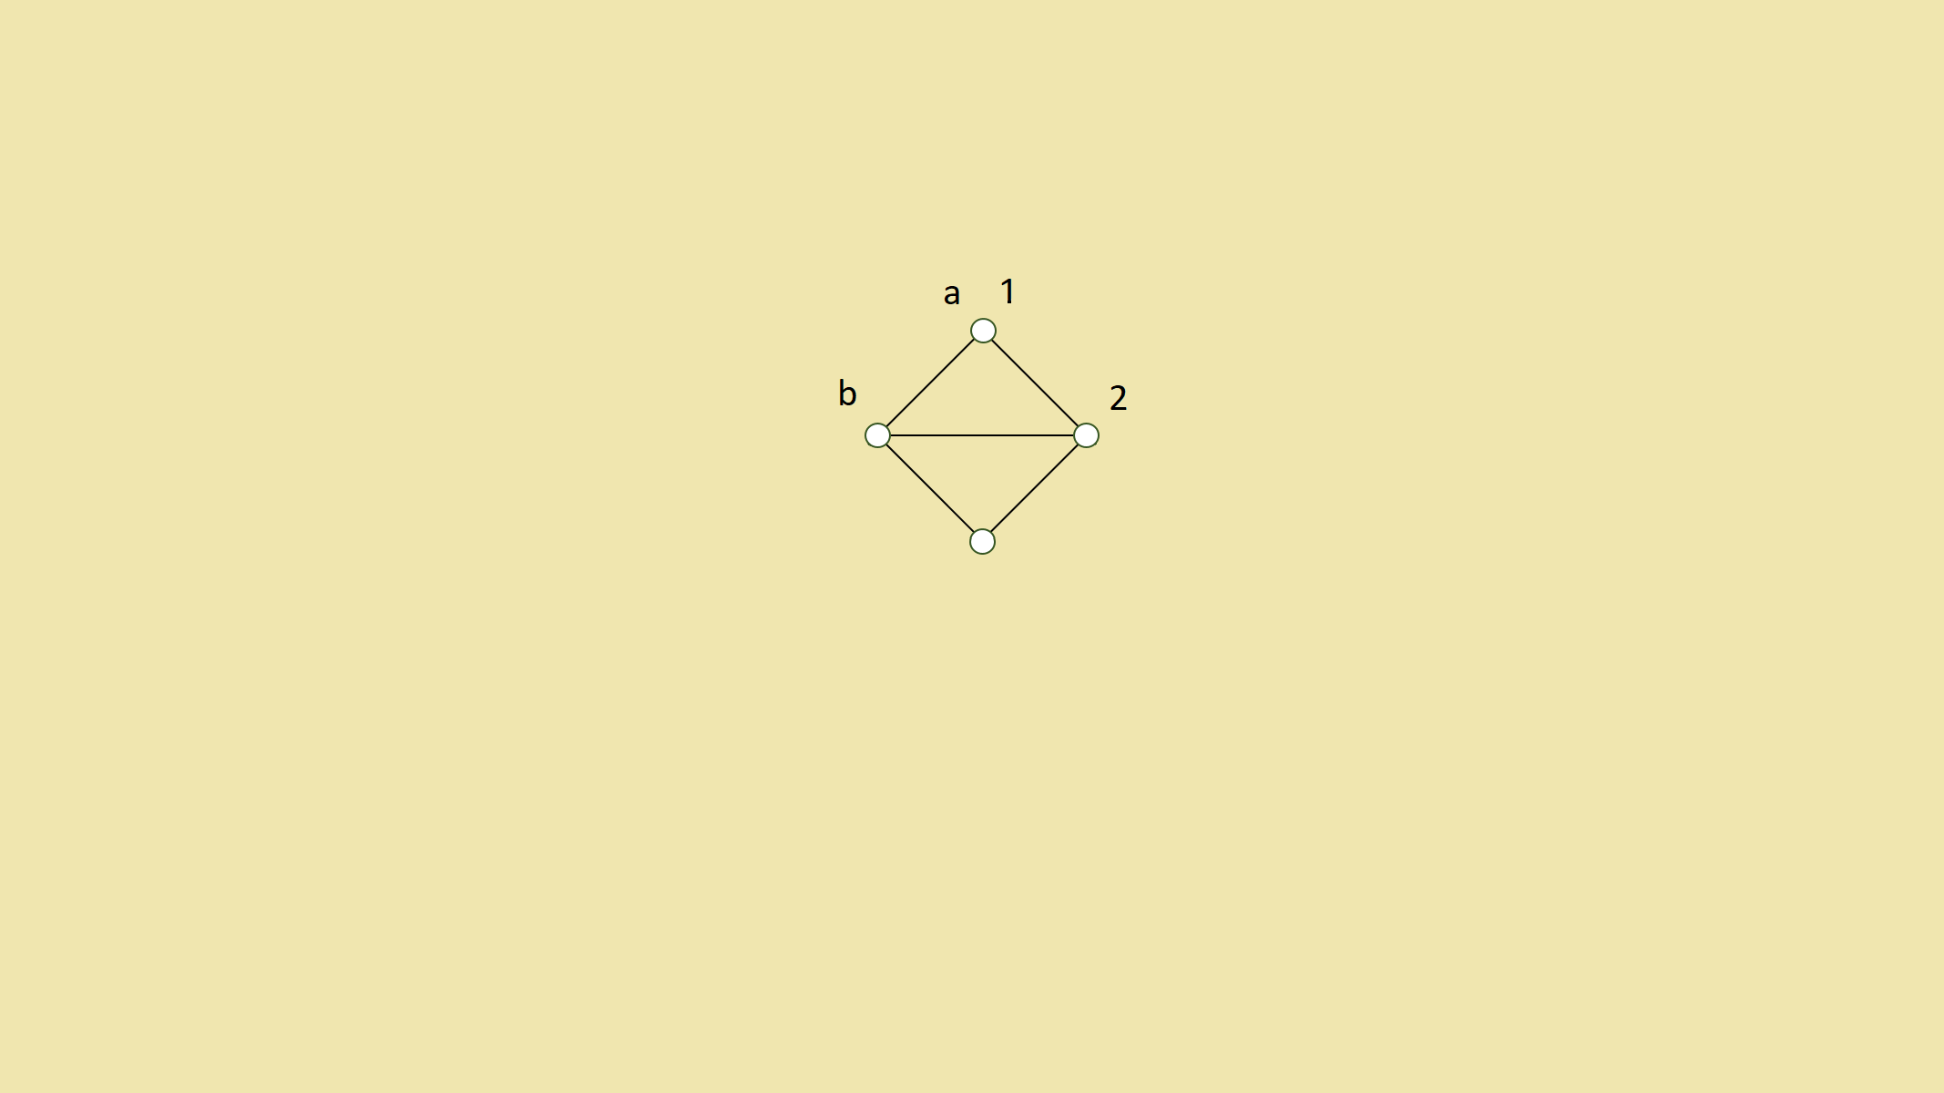
Chinese Checkers for Dummies

Slide 3
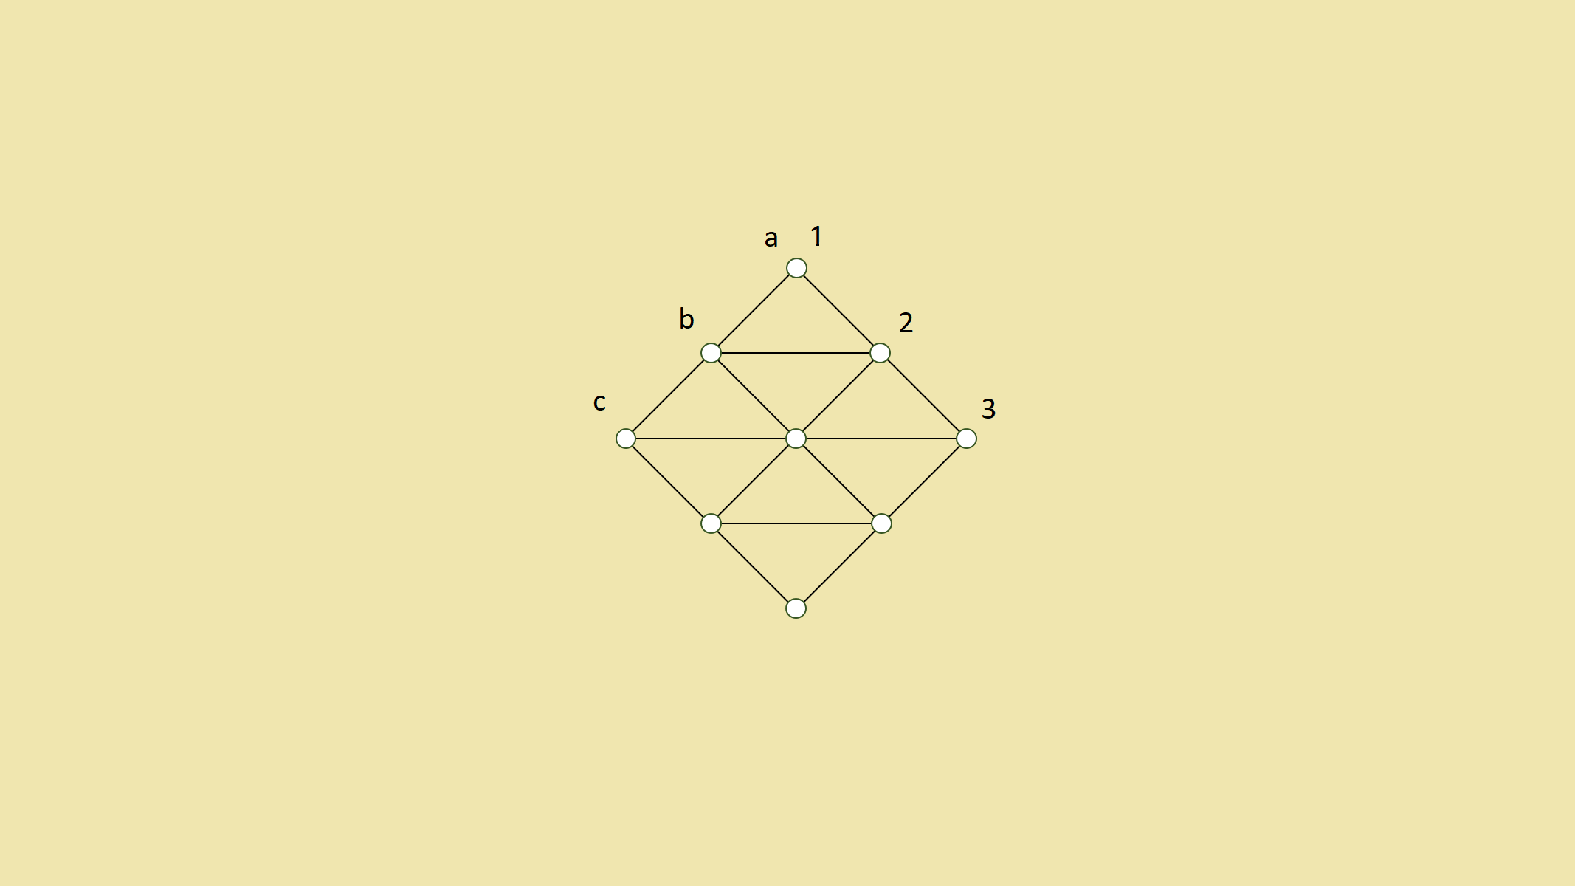
Chinese Checkers for Dummies

Slide 4
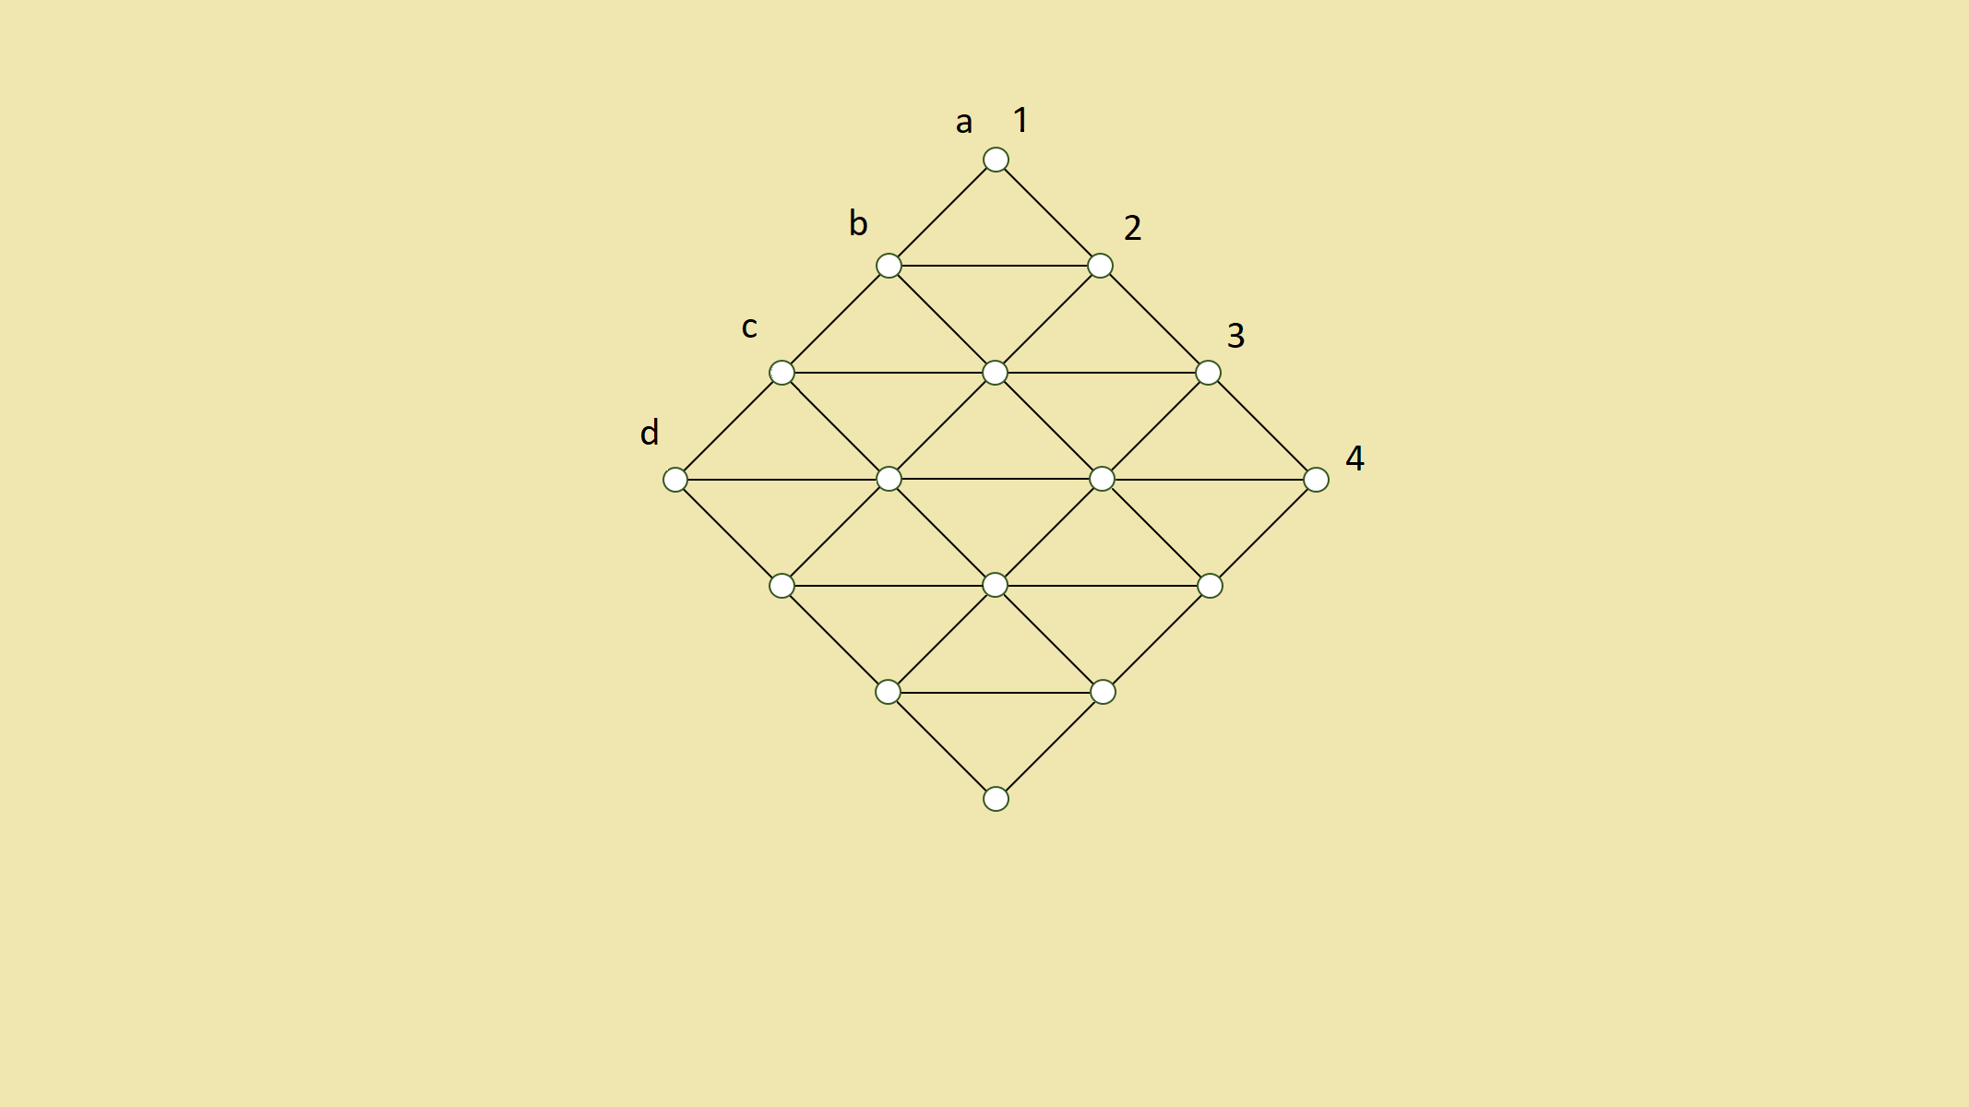
Chinese Checkers for Dummies

